Slide 1
SOFTWARE DEFINED RADIO
Presented by
UBAID UR REHMAN
Embedded Intern

Slide 2

What is Software Defined Radio?
Software Defined Radio (SDR) is commonly defined as a “Radio in which some or all of the physical layer functions are software defined”.
SDR technology uses software, instead of conventional hardware, to perform radio-signal processing functions. Filters, frequency tuners used in conventional systems can all be written in software.
Software defined devices can be reconfigured to adapt to changing product requirements.

Slide 3
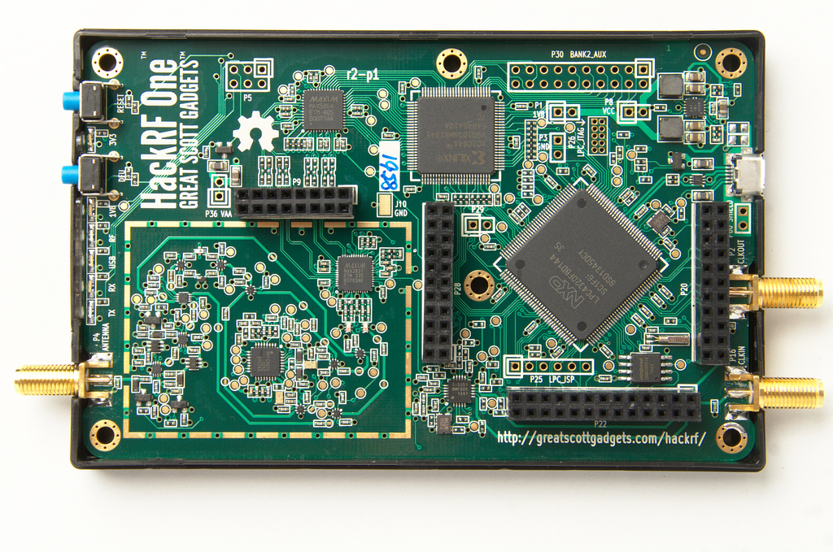
If Software Does Everything What is The Role of Hardware?
Hardware is still required for the RF front end and Analog to Digital Converter (ADC) and Digital to Analog Converter (DAC).
More on that later in the presentation.

Slide 4
BENEFITS
Below are several key features and benefits of using SDR:
Reduce development cost and time to market by integrating software blocks rather than hardware redesign
Reduce innovation cycle
Protection against hardware obsolescence
In-field updates/upgrade of system capability via software download
Single hardware platform can support multiple communications protocols via software application loads
Multi-purpose platform supporting multiple application domains (e.g. Radio/EW)
Development of domain specific applications can be initiated on personal computers or COTS platform
COTS eco-system to simplify the software development can be used

Slide 5
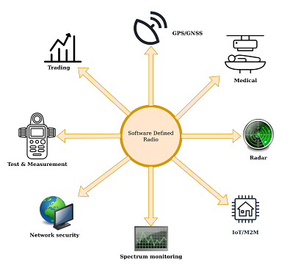
Applications of SDR
Public Safety.
Cell Phone Technology.
Military Applications.
Commercial use of SDR.

Slide 6
ARCHITECTURE OF SDR

Slide 7
Diff b/w conventional and software radio
 | Conventional Radio | Software Radio
Application | Supports a fixed number of systems Reconfigurability decided at the time of design. May support multiple services, but chosen at the time of design. | Dynamically Support multiple variable systems, and protocol interfaces. Interface with diverse systems. Provide a wide range of services with variable QoS.
Design | Traditional RF Design, Traditional baseband design | Conventional Radio + Software Architecture Reconfigurability
Upgradability | Cannot be made as future proof Typically radios are not upgradable | Ideally software radios could be future proof Software upgrading possible.

Slide 8
Hardware
Category | Frequency Range
Low Cost: RTL2832U-Realtek SDR Dongle | 24-1766Mhz.
Medium Cost: FunCube DonglePro + HackRF One BladeRF | 150 Khz – 2.05 Ghz 10 Mhz – 6 Ghz 300 Mhz – 3.8 Ghz
High Cost: USRP B200 USRP B210 UmTRX Matchstiq | 70 Mhz – 6 Ghz 70 Mhz – 6 Ghz 300 Mhz – 3.8 Ghz 300 Mhz – 3.8 Ghz

Slide 9
Software
Category | Description | Closed or Open Source
Windows, Mac and Linux GNU Radio GrOsmoSDR Linrad | Toolkit made by most SDR Software includes GNU Radio Companion Library used to interface with hardware Spectrum Viewer | Open Source Open Source Open Source
Windows SDR# HDSDR | Spectrum Viewer Spectrum Viewer | Closed Source Closed Source
Mac and Linux Gqrx | Spectrum Viewer | Open Source

Slide 10
Working of SDR
We will cover this in multiple slides and will follow this sequence.
Complex Signals.
Nyquist Theorem and Complex Signal
SDR Transmitter
SDR Receiver

Slide 11
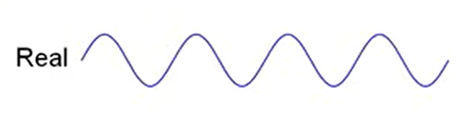
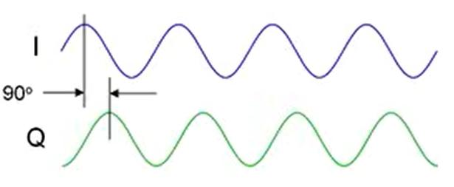
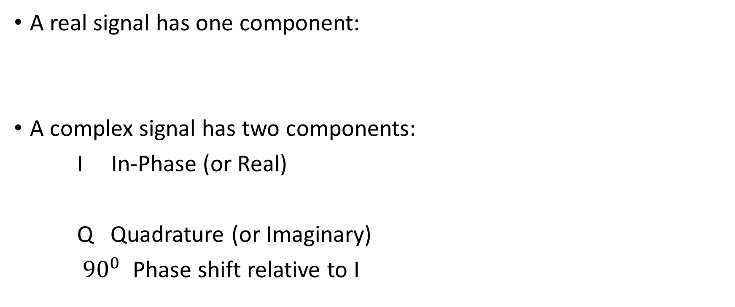
What is Complex Signal?
A real signal has one component:
A complex signal has two components:
I In-Phase (or Real)
Q Quadrature (or Imaginary)
${90}^{0}$ Phase shift relative to I

Slide 12
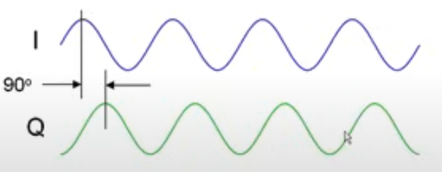
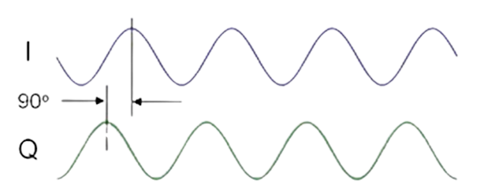
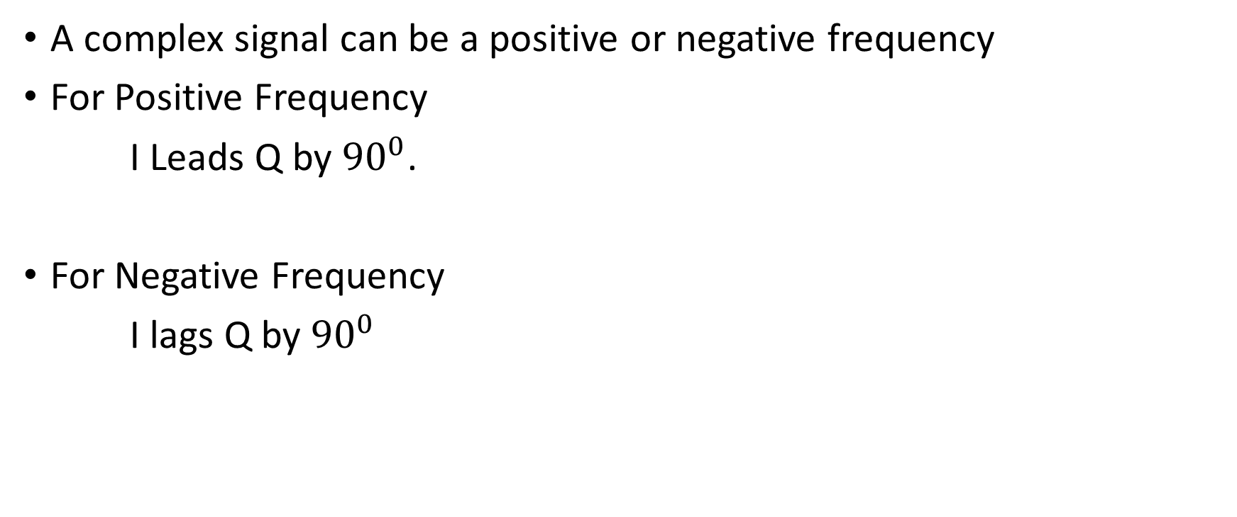
Positive and Negative Frequencies
A complex signal can be a positive or negative frequency
For Positive Frequency
I Leads Q by ${90}^{0}$.
For Negative Frequency
I lags Q by ${90}^{0}$

Slide 13
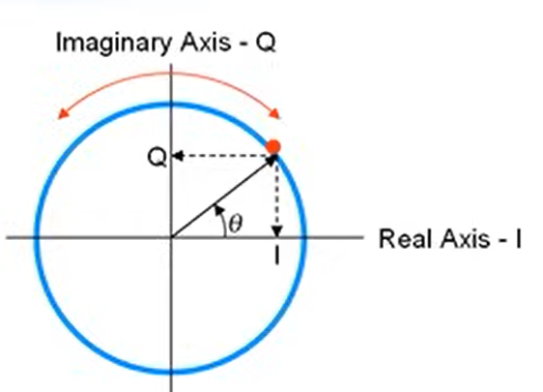
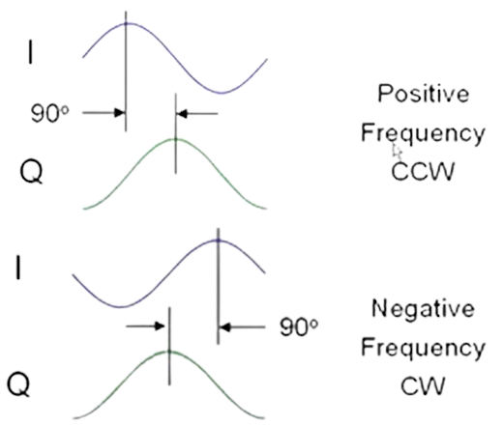
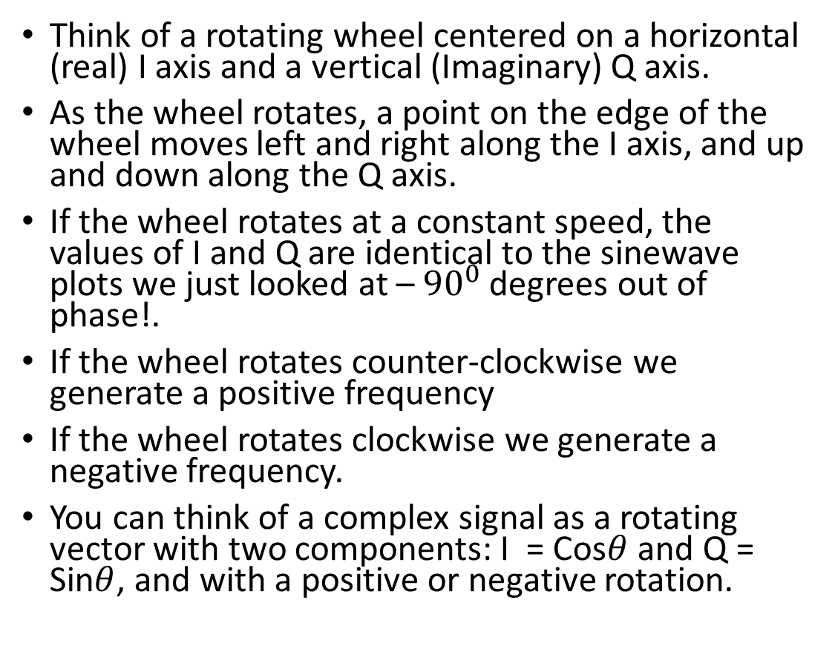
Complex Signals – Another View
Think of a rotating wheel centered on a horizontal (real) I axis and a vertical (Imaginary) Q axis.
As the wheel rotates, a point on the edge of the wheel moves left and right along the I axis, and up and down along the Q axis.
If the wheel rotates at a constant speed, the values of I and Q are identical to the sinewave plots we just looked at – ${90}^{0}$ degrees out of phase!.
If the wheel rotates counter-clockwise we generate a positive frequency
If the wheel rotates clockwise we generate a negative frequency.
You can think of a complex signal as a rotating vector with two components: I = Cos$θ$ and Q = Sin$θ$, and with a positive or negative rotation.

Slide 14
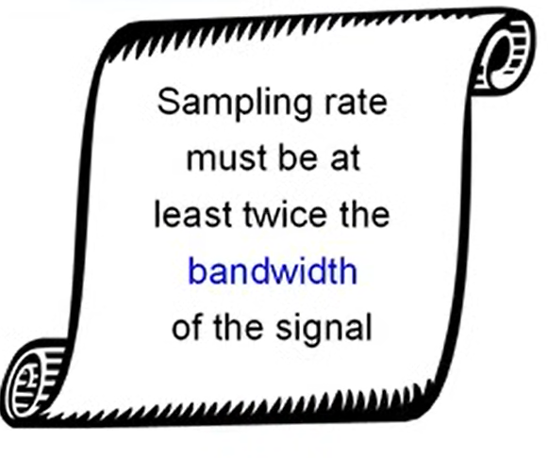
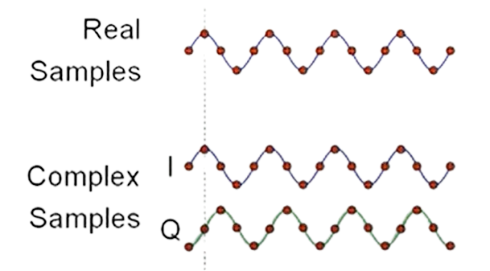
Nyquist Theorem and Complex Signals
Nyquist Theorem
For real signals, we have one digital value per sample.
For complex signals, we have two values per sample: I and Q.
A complex signal sample contains twice the information as a real signal sample.
As a result:
The Nyquist Theorem for complex sampling requires the sampling rate must be at least equal to the bandwidth of the signal.

Slide 15
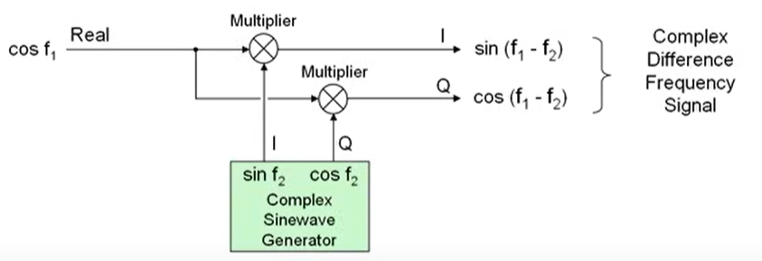
How To Make a Complex Signal
Multiply a real signal (f1) by a complex sinewave signal generator (f2)
Cosf1 x sinf2 = sin(f1-f2)
Cosf1 x Cosf2 = cos(f1-f2)
Remove the higher frequency sum components
Complex multiplication performs two operation:
Translates the input signal (f1) down to the difference frequency (f1-f2)

Slide 16
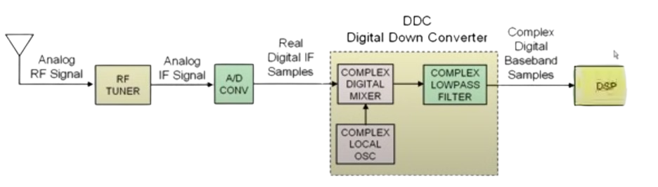
SDR Receiver
RF Tuner down converts analog RF signals to analog IF Frequencies.
A/D Converter digitizes the IF signal creating real digital samples.
Digital Mixer and Local Oscillator translate digital IF to complex baseband
Digital FIR Low Pass filter limits the complex baseband signal bandwidth.
DDC = Complex Mixer + Local Oscillator + Decimating Low Pass Filter.
Digital Signal Processing stage performs signal demodulation, etc.

Slide 17
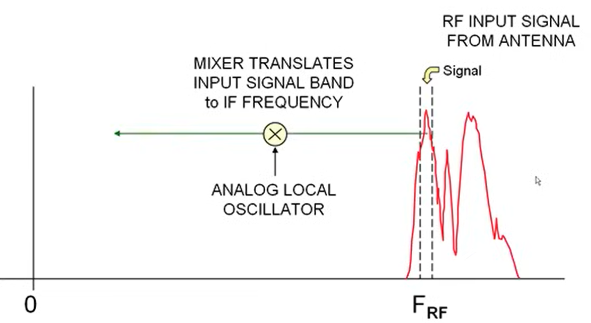
Analog RF Tuner IF Filter
IF Band Pass Filter passes only the signal bandwidth of interest

Slide 18
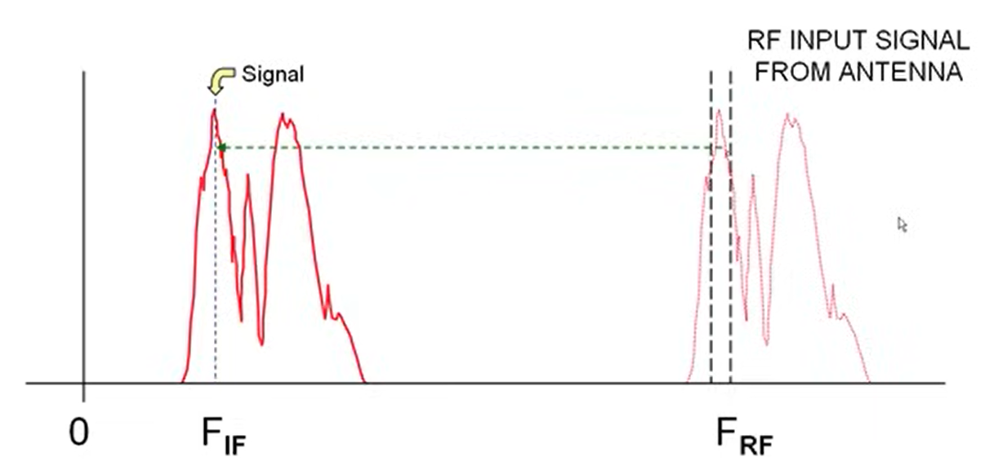
Analog RF Tuner IF Filter
IF Band Pass Filter passes only the signal bandwidth of interest

Slide 19
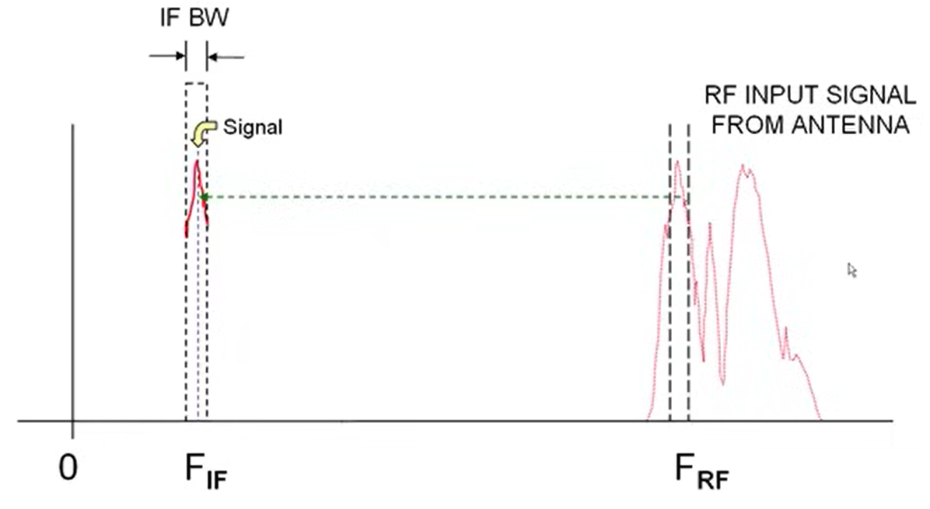
Analog RF Tuner IF Filter
IF Band Pass Filter passes only the signal bandwidth of interest

Slide 20
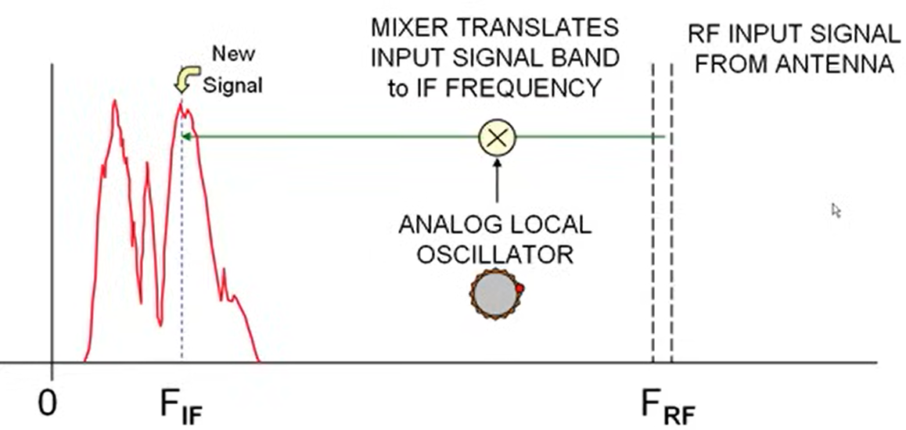
Analog RF Tuner Receiver Mixing
Suppose you want to receive a different signal
Frequency translation (amount of shift) is controlled by setting local oscillator frequency
Tune to another “station” by changing the local oscillator frequency.

Slide 21
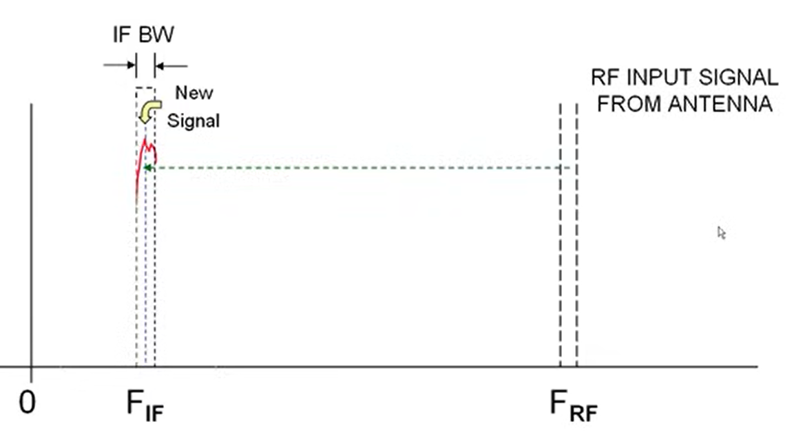
Analog RF Tuner Receiver Mixing
IF Band Pass Filter passes only the new signal instead.

Slide 22
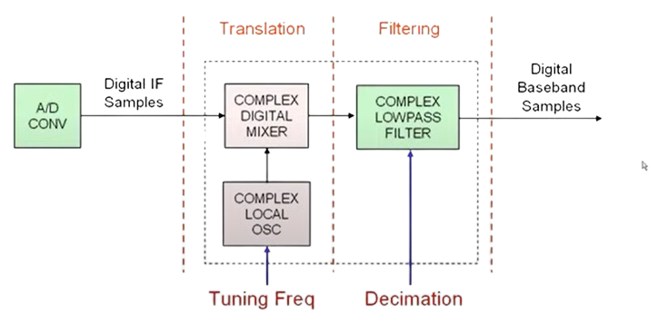
DDC: Two-Step Signal Processing
Frequency Translation
Tuning (down conversion frequency) is controlled by Local Oscillator Setting
Low Pass Filtering
Decimation Setting controls filter bandwidth AND decimation
As the filter bandwidth becomes lower, the decimation factor increases.

Slide 23
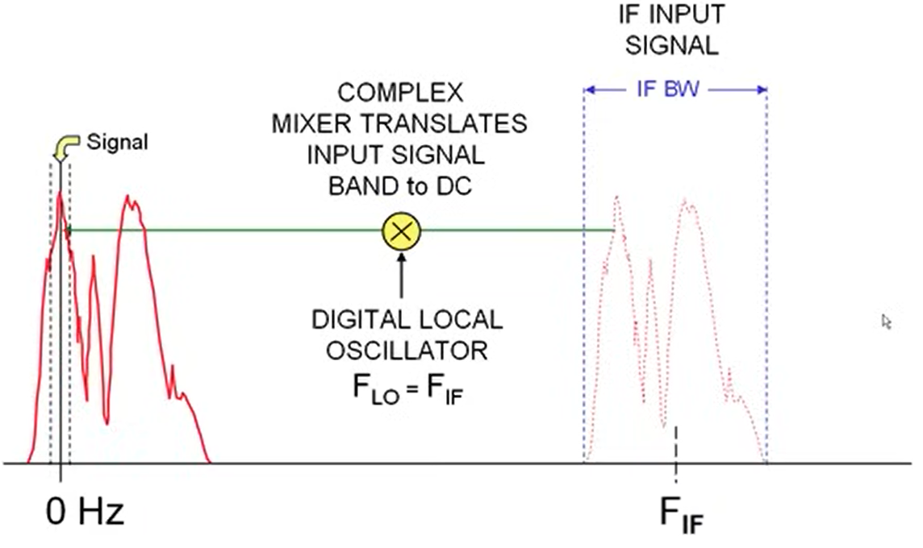
Complex Digital Translation
IF band contains several signals within its bandwidth
Digital complex mixer translates desired input signal within the IF band directly down to 0 Hz or DC as a complex signal.

Slide 24
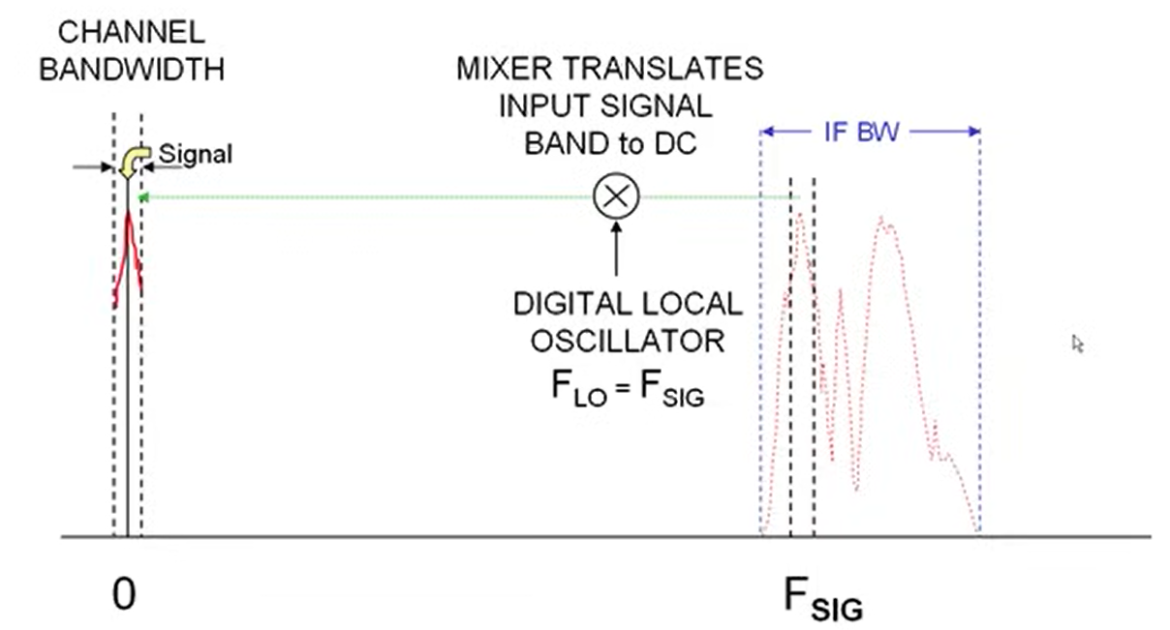
Filter Band limiting
Complex Low Pass Filter bandwidth is set to match desired bandwidth of received channel.
At the output of the Low Pass Filter, the complex baseband signal bandwidth has been reduced

Slide 25
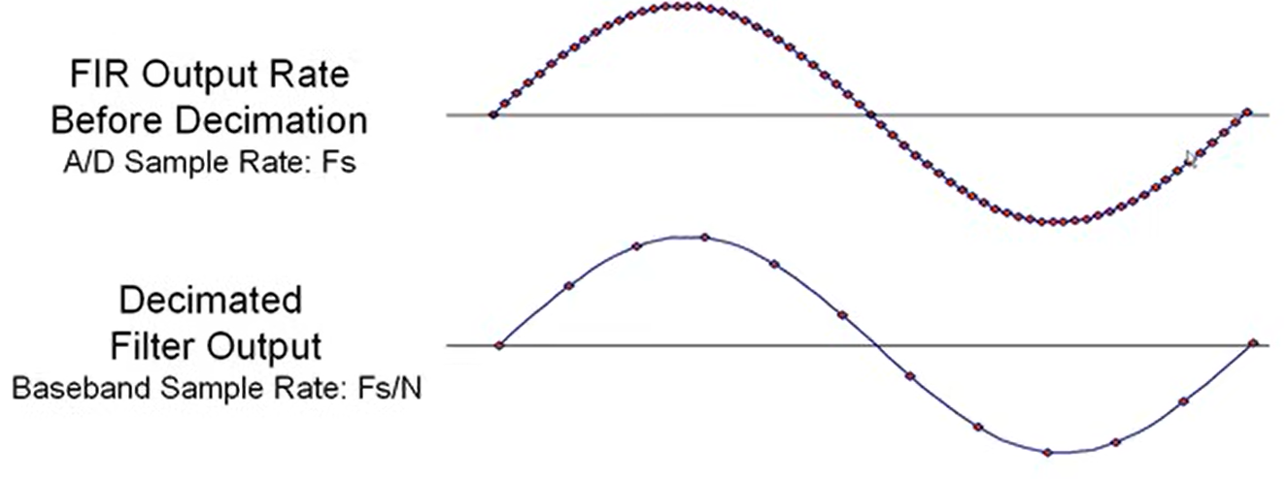
LPF Output Signal Decimation
Since the LPF output is band limited. Nyquist tells us we can lower the sample rate.
Decimation means keeping one of every N samples.
If the decimated output sample rate is kept above Nyquist limit, no information is lost
Benefit: Same information can be processed easier in DSP, transmitted at a lower rate, or stored in less memory

Slide 26
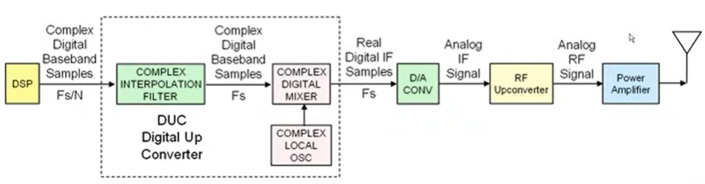
Software Radio Transmitter
DSP stage generates complex baseband digital signal
Digital up Converter translates complex digital baseband to real IF.
D/A converter converts real digital IF samples to analog IF signal.
RF Upconverter translates analog IF signals to analog RF Frequencies
Power amplifier boosts signal energy to antenna.

Slide 27
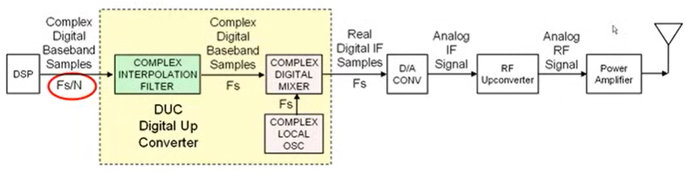
Digital Upconverter
D/A output rate must be high enough to satisfy Nyquist for IF output.
Digital Mixer translates baseband samples up to IF frequency.
Mixer must deliver output samples at the D/A sample rate.
Mixer generates one output samples for each of two input samples.
Local Oscillator & baseband sample rate must be at D/A sample rate.
Digital baseband input sample rate is much lower.
Interpolation filter solves the problem!

Slide 28
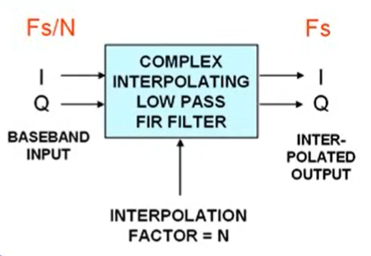
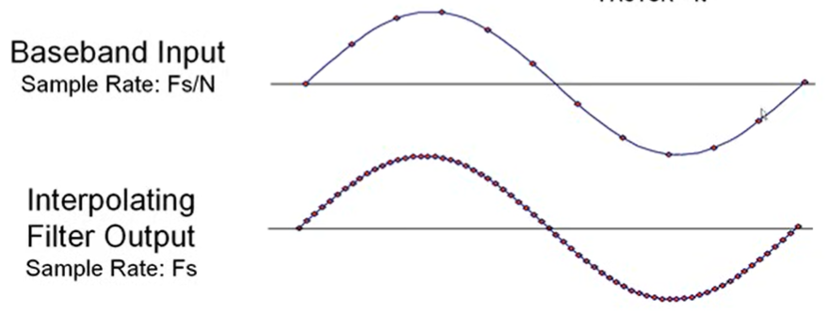
Complex Interpolating Filter
Interpolation filter increases the sampling rate of the complex baseband input signal.
Interpolation Factor N determines the ratio.
Interpolation does NOT change the baseband frequency - just increases the sample rate.

Slide 29
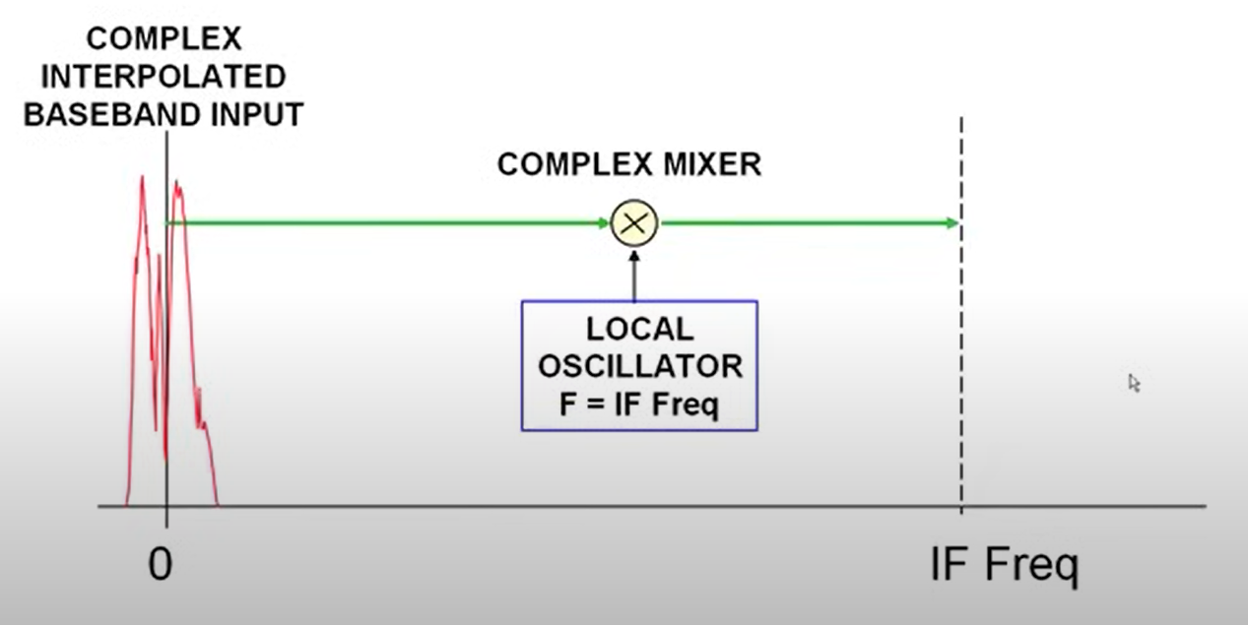
Frequency Domain View
Now, the interpolated baseband sample rate matches the Fs rate required at the mixer input.
Digital mixer translates complex baseband signal up to an IF Frequency.

Slide 30
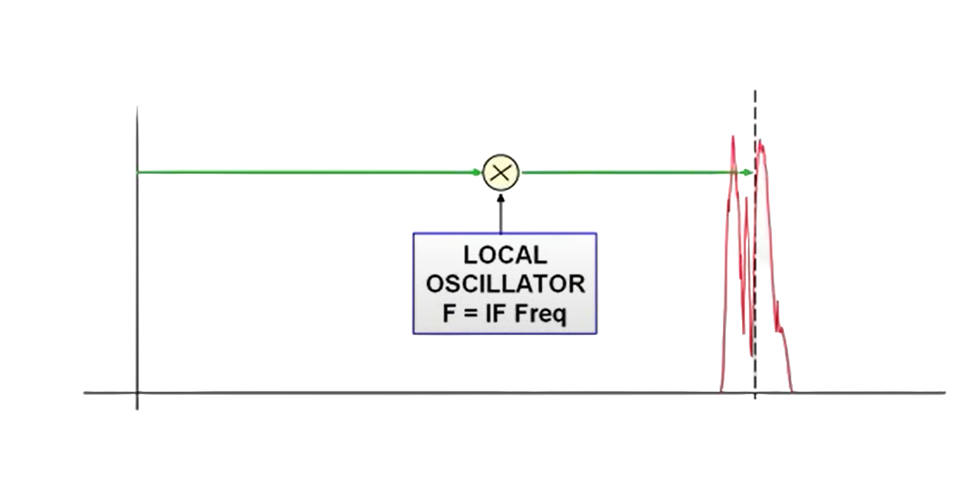
Frequency Domain View
Now, the interpolated baseband sample rate matches the Fs rate required at the mixer input.
Digital mixer translates complex baseband signal up to an IF Frequency.
Complex Interpolation Band
Complex Mixer
0
IF Freq

Slide 31
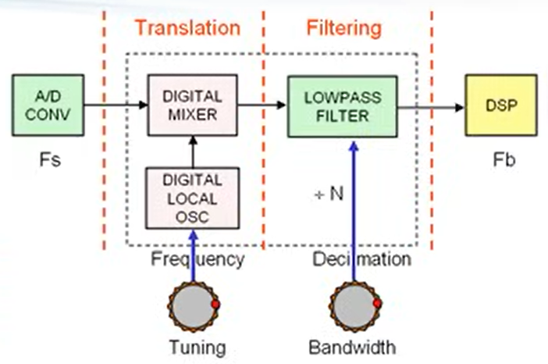
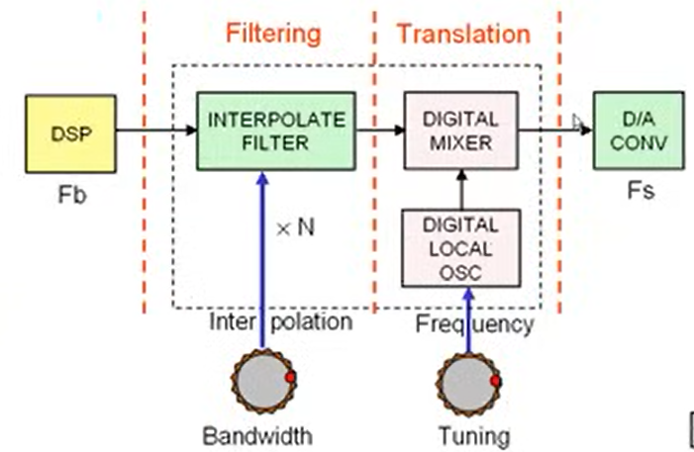
DDC and DUC: Two-Step Signal Processors
Digital Down Conversion- DDC
Frequency Translation
Local Oscillator Setting
Low Pass Filtering
Decimation and Bandwidth Setting
Baseband Sample Rate Fb = Fs/N
Baseband Bandwidth = 0.8 x Fb
Digital Up Conversion- DUC
Frequency Translation
Local Oscillator Setting
Interpolation Filtering
Interpolation and Bandwidth Setting
Output Sample Rate Fs = Fb x N

Slide 32
Conclusion
Software Defined Radios are configured easily.
They can be used extensively.
They are helpful and useful in RF World!.

Slide 33
References
[1] https://en.wikipedia.org/wiki/Software-defined_radio
[2] https://greatscottgadgets.com/hackrf/one/
[3] https://www.sciencedirect.com/topics/engineering/software-defined-radio
[4] https://www.viavisolutions.com/en-us/what-software-defined-radio-sdr
[5] https://www.everythingrf.com/community/what-is-a-software-defined-radio

Slide 34
THANK YOU!

